Slide 1
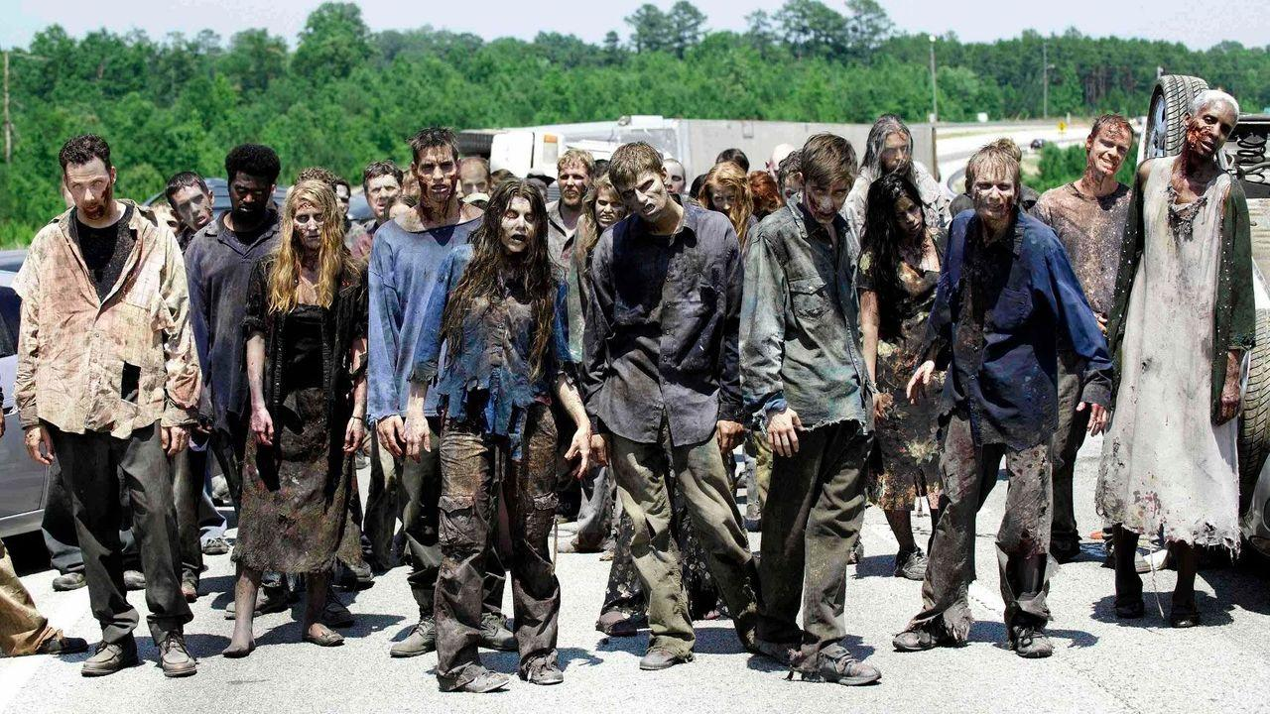
Zombie Apocalpyse:
A Thought Experiment
Group Argument Activity

Slide 2
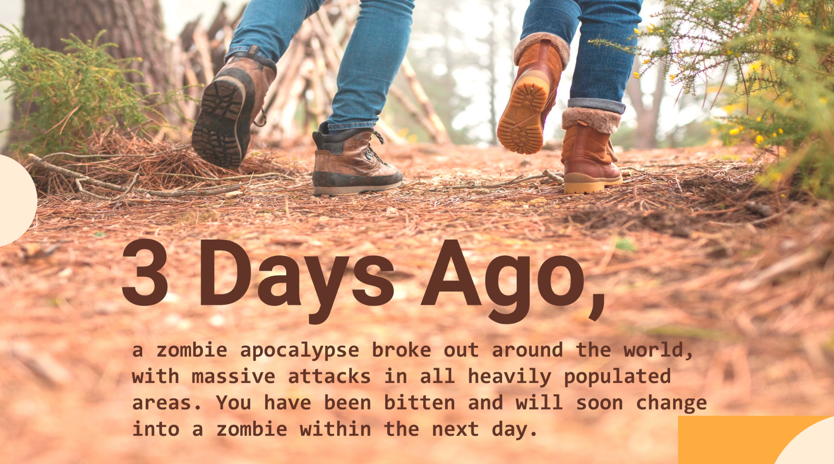

Slide 3
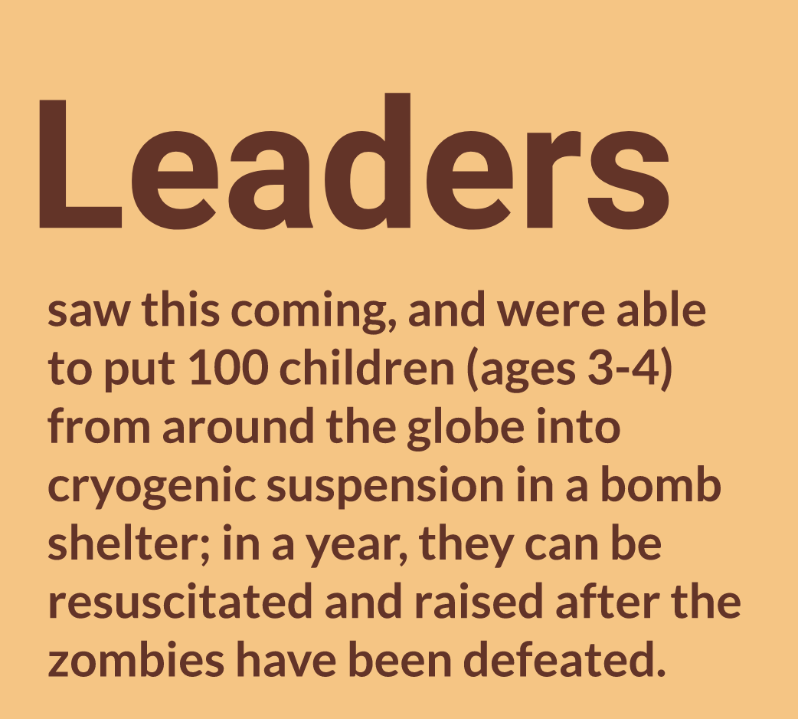


Slide 4
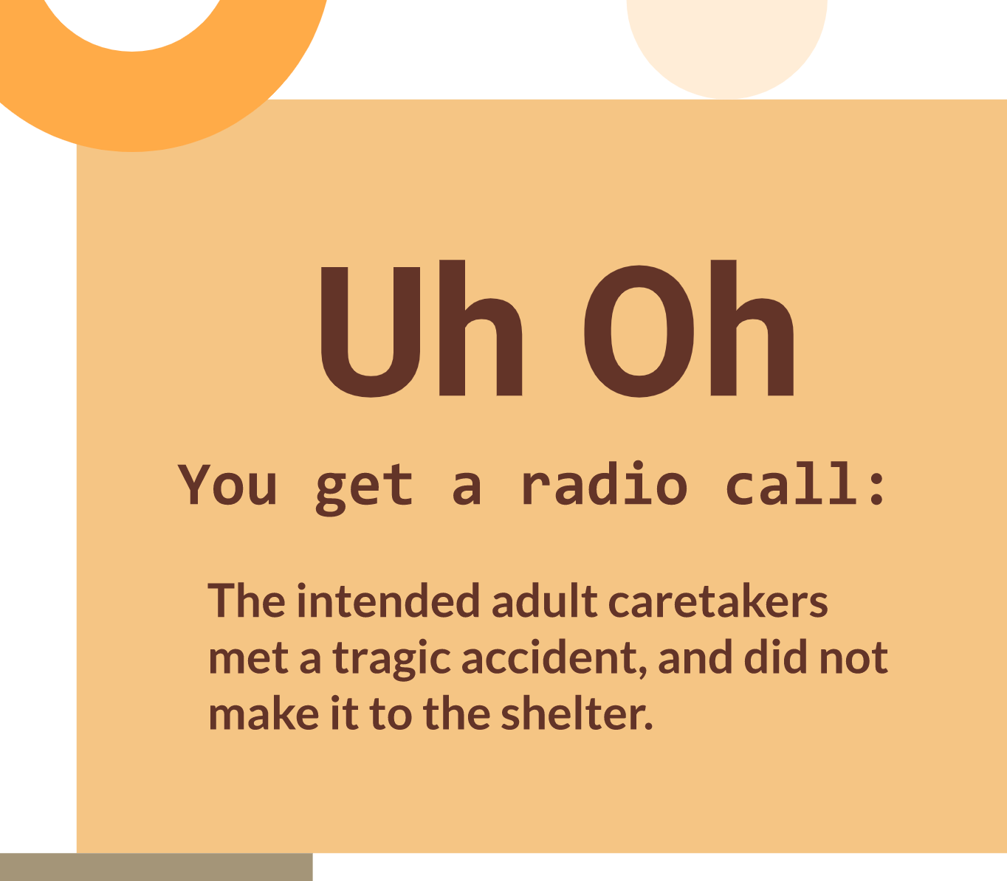
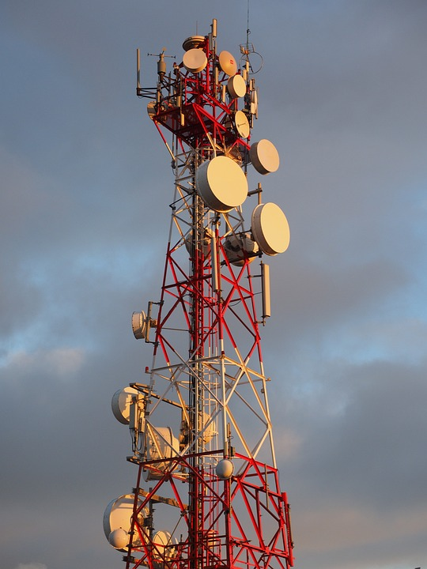

Slide 5
However, ten other adults made it, but there is only enough food, air, and other supplies to keep three of these adults alive until the zombies have been erradicated. As the leaders, it is up to you to decide.
These will be the only adults around to raise these children and set up the future society.

Slide 6
Choose three. You should have reasons for your choices. You have 10 minutes.
*Note on images (all images were AI generated)

Slide 7
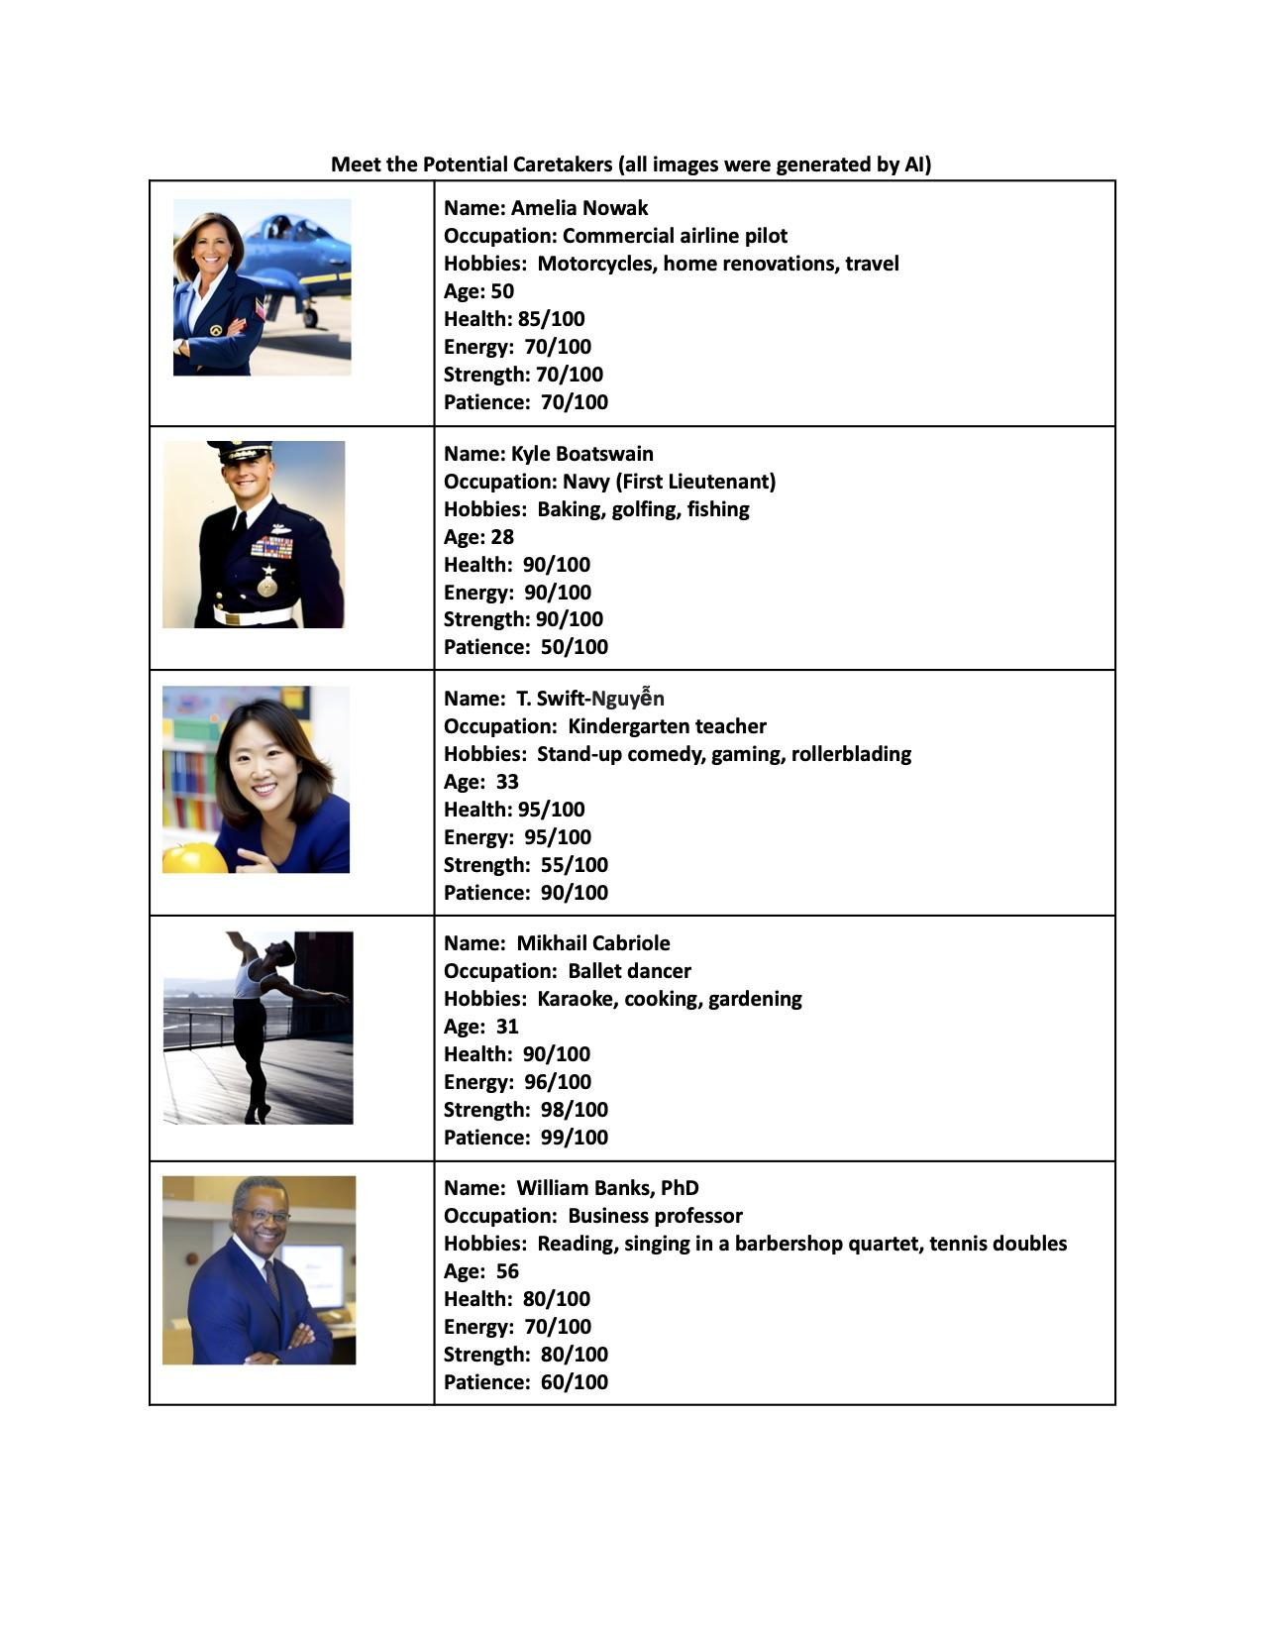


Slide 8
In your small groups, deliberate on which three of these ten potential caretakers will be the ones tasked with the future. There are no loopholes. There is no additional information. You must choose three.

Slide 9
Make Your Case
Choose one member of your group of leaders to make your case for the three caretakers that you have chosen. Each group will have 1 minute to make their case.

Slide 10
DISCUSSION

Slide 11
VOTE

Slide 15
Thought Experiment Part II
You and your classmates have all survived, but there is only enough food, air, and other supplies to keep one of you from each group alive until the zombies have been eradicated. Your small group must decide which one of you will be a caretaker of the future.

Slide 16
Pre-Discussion Brainstorming
Brainstorm why you should be the person from your group chosen to be the caretaker and write a brief argument advocating on your own behalf. You have two minutes to brainstorm.

Slide 17
Now, share your arguments in your small group. Each group member has no more than one minute. Next, deliberate as a group and choose ONE person from your group to be the caretaker.

Slide 18
Now, choose one person from your group to argue for your chosen care taker, because it turns out that there is only room for ONE person to be the caretaker. The person has one minute to argue for your chosen caretaker.

Slide 19
VOTE

Slide 20
Debriefing
What are the limits of this thought experiment?
What are the ethical considerations?
Did the thought experiement change when you became potential caretakers? How?
Did you consider audience when advocating for potential caretakers? Explain.
What were the most convincing rhetorical moves made in the thought experiment?
What was your line of reasoning?

Slide 21
Write a thesis/claim statement in which you take a position on the thought experiment itself.
A strong thesis is:
Compelling: They evoke interest and attention
Debatable: Not a statement of fact
Defensible: Supported with relevant, reliable evidence, and the connections are explained by the writer through a careful line of reasoning

Slide 22
The AP Language & Composition Test
One Hour: 45 Multiple-Choice Questions (5 question sets on passages)
23-25 rhetorical analysis questions that examine your skills at analyzing rhetoric and 20-22 writing questions that require you to consider revisions to text that you are shown.
Two Hours: Essay Writing a.k.a “Free Response” a.k.a. FRQ or Free-Response Question(s)
The FRQ Types:
Synthesis: You will be given several (most likely six) texts to read and you will choose some of the texts (probably three) to create an argument for a given prompt.
Rhetorical Analysis: You will be given a nonfiction passage (speech, letter, essay, etc.) to analyze for the rhetorical choices the writer makes.
Argument: You will be given a prompt from which to create and advance a sophisticated argument thesis through your purposeful rhetorical choices.

Slide 23

Our Approach
A Spiral Curriculum: We will revisit these same
big concepts throughout the course to deepen
complexity and our our level of understanding:
■ Rhetorical Situation: Individuals write within a particular situation and make
strategic writing choices based on that situation. (RHS)
■ Claims and Evidence: Writers make claims about subjects, rely on evidence that
supports the reasoning that justifies the claim, and often acknowledge or respond
to other, possibly opposing, arguments. (CLE)
■ Reasoning and Organization: Writers guide understanding of a text’s lines of
reasoning and claims through that text’s organization and integration of evidence. (REO)
■ Style: The rhetorical situation informs the strategic stylistic choices that writers
make. (STL)

